Slide 1
MACHINE LEARNING PROJECT
CLASSIFICATION OF HEART DISEASE(WITH GIVEN SYMPTOMS)
Prof – S. S. Udmale

Slide 2
Understanding Problem
Classification of heart disease refers to the process of categorizing or predicting the presence or absence of heart-related conditions or outcomes based on input features or data related to a patient's heart health. It is a supervised machine learning task where the goal is to build a model that can accurately classify patients into different groups or classes representing specific heart conditions.
The classification process involves training a machine learning algorithm using a labeled dataset, where each data point (patient) is associated with a class label that indicates whether they have a particular heart disease or not. The algorithm learns from this labeled data to identify patterns and relationships between input features and corresponding class labels.
The input features used for classification can include various patient-specific attributes such as age, gender, blood pressure, cholesterol levels, blood glucose levels, ECG readings, symptoms, medical history, lifestyle factors, and family medical history.
The model's ultimate objective is to generalize its learning from the training data and accurately predict the class label of new, unseen data. For example, it can predict whether a patient is at risk of heart disease, the presence and severity of specific heart conditions, or the likelihood of experiencing heart-related complications in the future.
Classification of heart disease using machine learning techniques has significant implications for early diagnosis, personalized treatment planning, and improved patient care. It aids healthcare professionals in making informed decisions, potentially reducing the burden of heart-related diseases and contributing to better health outcomes for patients.

Slide 3
Steps in Naiive Bayes Model
Data Preparation - Obtain a labeled dataset with features (attributes) and corresponding class labels. Preprocess the data, handle missing values, and encode categorical features into numerical representations.
Calculate Class Priors - Calculate the prior probabilities of each class in the dataset. This involves counting the occurrences of each class in the training data.
Calculate Likelihoods - For each feature and class combination, calculate the likelihood of observing that feature value given the class label. This is done by counting the occurrences of the feature values within each class.
Apply the Naive Bayes Formula - Given a new instance with input features, use Bayes' theorem to calculate the posterior probability for each class. The class with the highest posterior probability is the predicted class for the new instance.
Make Predictions - Repeat the above step for all new instances in the test set to make predictions for their class labels.
Evaluate the Model
Naive Bayes theorem is a simple and widely used probabilistic algorithm for classification. It is based on Bayes' theorem and assumes that the features are conditionally independent given the class label.

Slide 4
Steps in Logistic Regression
Data Preprocessing - Clean and preprocess the dataset, handling missing values and outliers. Split the data into features (X) and labels (y). Scale or normalize the numerical features for better convergence of the algorithm.
Sigmoid Function - Define the Sigmoid function, also known as the logistic function. It transforms any real-valued number to the range [0, 1].
Hypothesis Function - Create the hypothesis function, which combines the sigmoid function with linear regression to model the probability of an instance belonging to the positive class (class 1).
Cost Function (Log Loss) - Define the cost function (also known as the log loss or binary cross-entropy). It quantifies the difference between the predicted probabilities and the actual labels.
Gradient Descent - Use gradient descent or other optimization techniques to minimize the cost function and find the optimal weights that best fit the data.
Model Training - Iterate through the dataset to update the model's weights iteratively, reducing the cost function at each step.
Model Evaluation - Evaluate the model's performance on a separate test dataset using evaluation metrics such as accuracy, precision, recall, F1-score, or ROC-AUC.
Decision Boundary - Visualize the decision boundary to understand how the model separates the two classes.
Predictions - Use the trained model to make predictions on new, unseen data.
Model Interpretation - Analyze the weights learned by the model to interpret the importance of each feature in the classification task.
Logistic Regression is a popular statistical and machine learning technique used for binary classification tasks. It predicts the probability of an instance belonging to a particular class (usually 0 or 1) based on input features.

Slide 5
Steps in Decision Tree
Data Collection - Gather the dataset containing samples with their corresponding features and class labels (for classification) or target values (for regression).
Data Preprocessing - Handle missing values and outliers in the dataset to avoid biases in the decision tree's construction. Encode categorical features into numerical representations if necessary.
Tree Building - Select a target feature (class label for classification or target value for regression) to predict. Choose a feature (attribute) from the dataset to split the data into subsets at each node of the tree. Measure the impurity or purity of the subsets using a criterion such as Gini Index (for classification) or Mean Squared Error (for regression). Determine the best feature and split point that maximizes the information gain or minimizes the impurity measure at each node. Recursively create child nodes for the subsets based on the selected features and split points until a stopping criterion is met. This may include a maximum tree depth, minimum number of samples per leaf node, or other user-defined parameters.
Prediction - Use the trained decision tree to make predictions on new, unseen data by following the learned rules at each node to traverse the tree and reach the appropriate leaf node, which provides the final prediction (class label for classification or target value for regression).
Model Evaluation - Evaluate the performance of the decision tree model on a separate test dataset using appropriate metrics such as accuracy (for classification) or mean squared error (for regression).
The decision tree algorithm is a supervised learning technique used for both classification and regression tasks. It works by recursively partitioning the dataset into subsets based on the values of input features, resulting in a tree-like structure where each internal node represents a decision based on a specific feature, and each leaf node represents a class label or a predicted value.

Slide 6
Other models that can be used
Support Vector Mechanism - Support Vector Machine (SVM) is a powerful supervised learning algorithm used for classification and regression tasks. In the context of classification, SVM aims to find the optimal hyperplane that best separates different classes in the feature space.
Neural Network - In a neural network, the mechanism involves building a computational model inspired by the structure and function of the human brain's interconnected neurons. It is a powerful machine learning technique used for various tasks, including classification, regression, and pattern recognition.
Random Forest - Random Forest is an ensemble learning method that combines multiple decision trees to create a powerful and robust predictive model. It is widely used for both classification and regression tasks and is known for its high accuracy and ability to handle complex datasets.

Slide 7
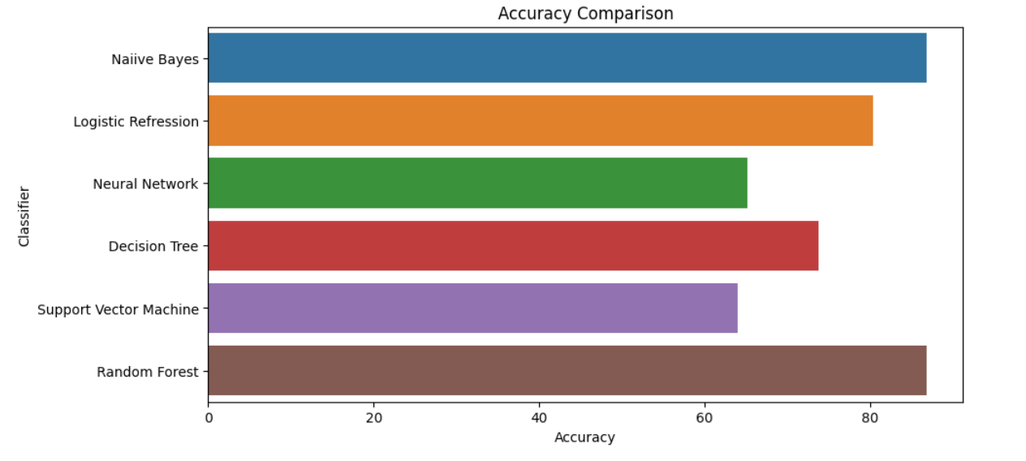
Accuracies

Slide 8
CONCLUSION
After comparing the accuracy and precision of several classifiers, we gotto know that Naive Bayes has the highest accuracy.Also the precision shown by Naive Bayes was best among all.So, we preferred to go with Naive Bayes algorithm to implement ourmachine learning model and host it on the internet.

Slide 9
THANK YOU
NAGARDHANKAR DHAWAL MANOJ
201080063
INFORMATION TECHNOLOGY

